Slide 1
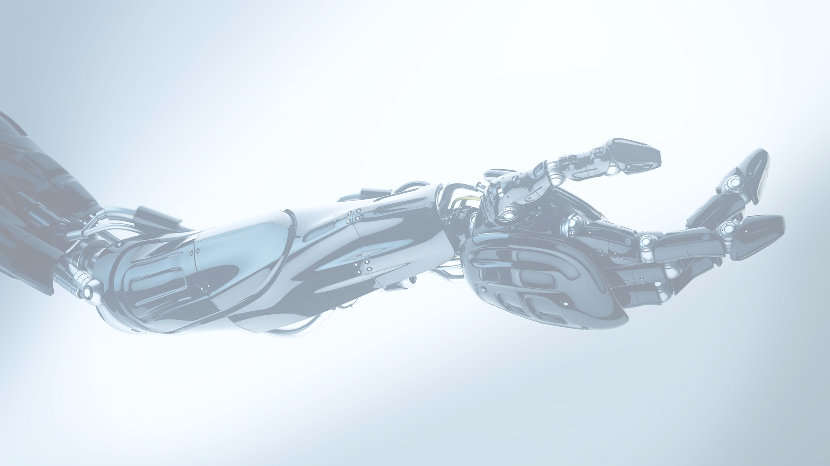


Slide 2
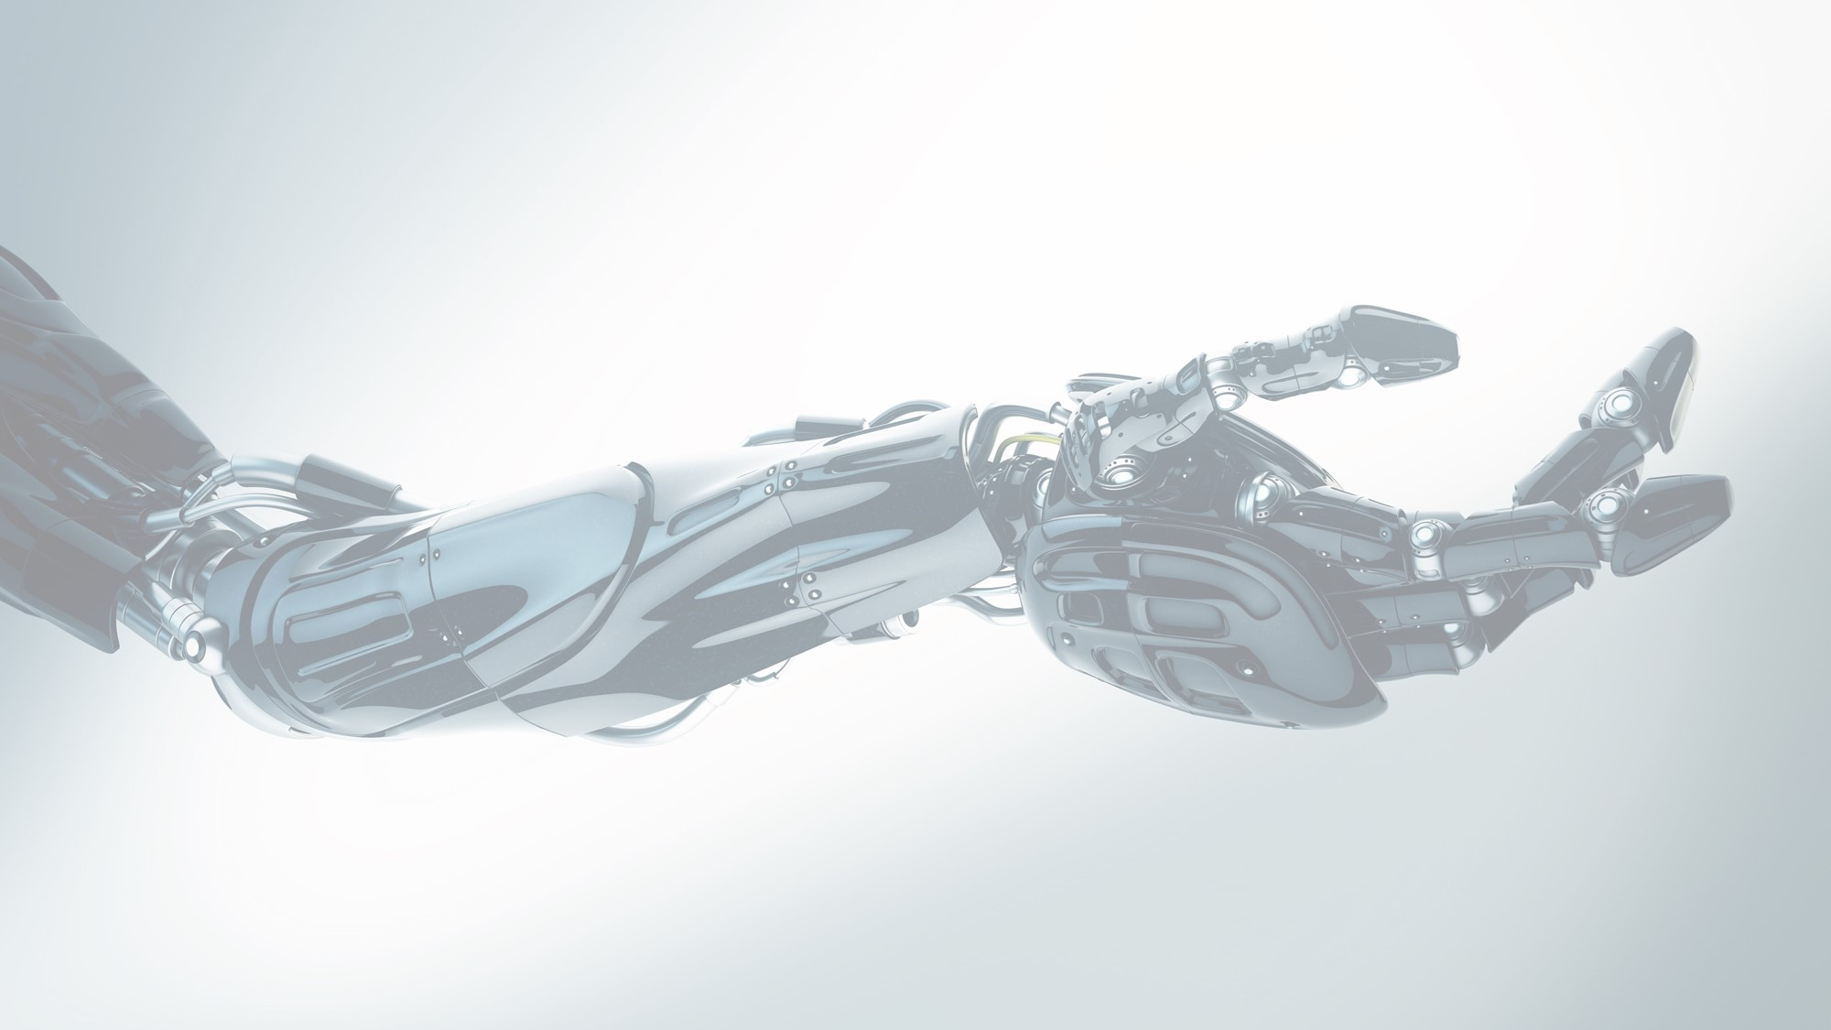
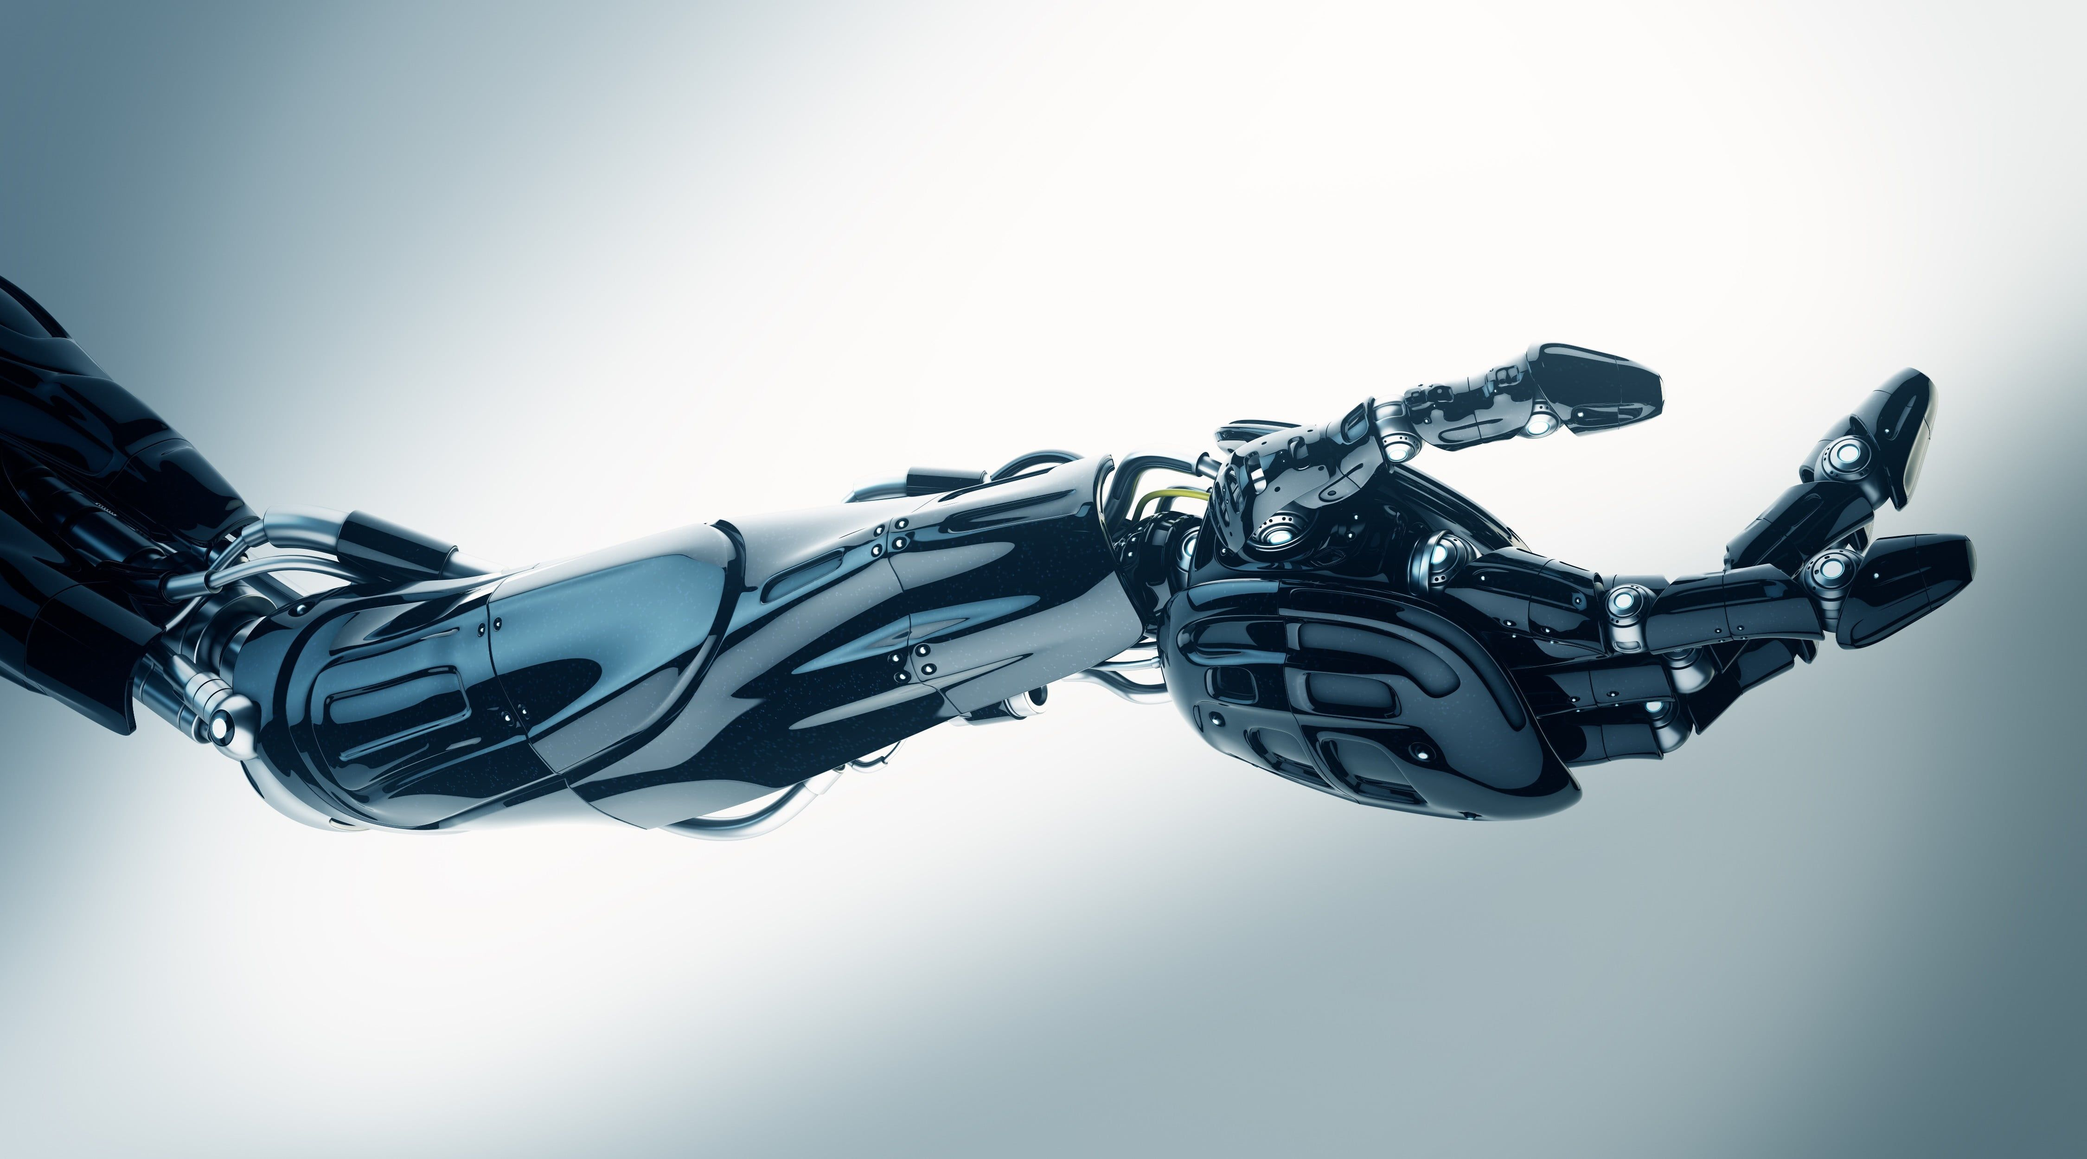
A ROBOTIC ARM
Microprocessors Systems

Slide 3
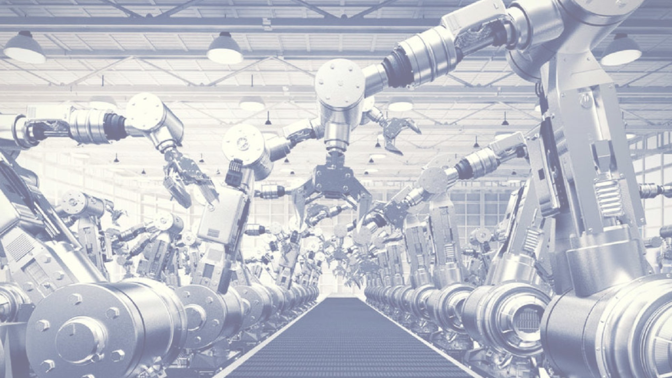
GROUP MEMBERS
S.no. | Names | CMS
1. | CH M Shaheer Yasir | 286021
2. | Muhammad Hamza | 290951
3. | M Saud Zahir | 294897

Slide 4
INTRODUCTION TO PROJECT
A robot is a reprogrammable, multifunctional manipulator designed to move materials, parts, tools or specialized devices through variable programmed motions for the performance of a variety of tasks.
The primary objective is to make an anthropomorphic Robotic arm comprising of stepper motors to interface with the Intel AT89C51- microcontroller.
The function of this arm is to position and orient the hand, act as a mechanical connection and power and sensing transmission link between the hand and the main body of the user.

Slide 5
DESCRIPTION OF PROJECT
It employs designing and constructing the robotic arm are based on the operational characteristic and features of the microcontrollers, stepper motors, the electronic circuit diagram and most importantly the programming of the microcontroller and stepper motors.

Slide 6
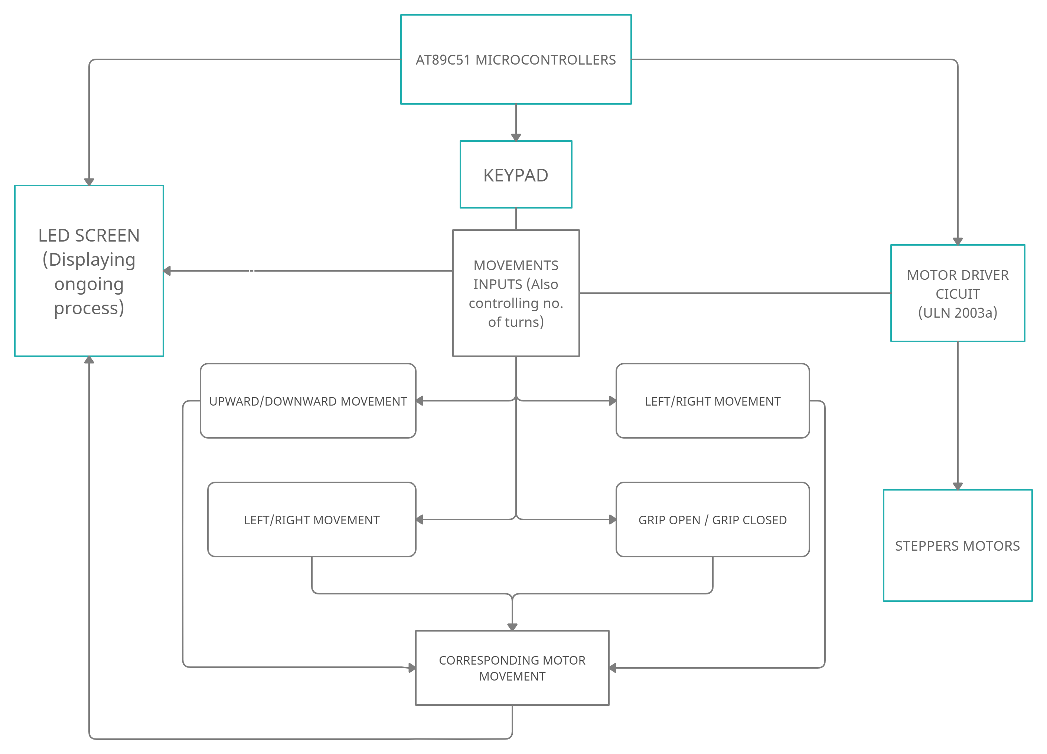
ASM CHART
FWD/REVERSE MOVEMENT

Slide 7
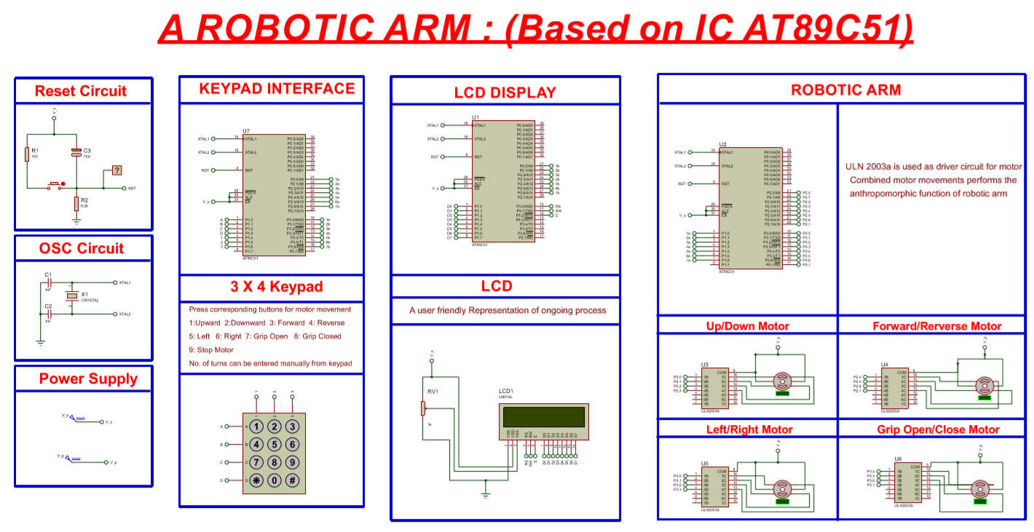

Slide 8
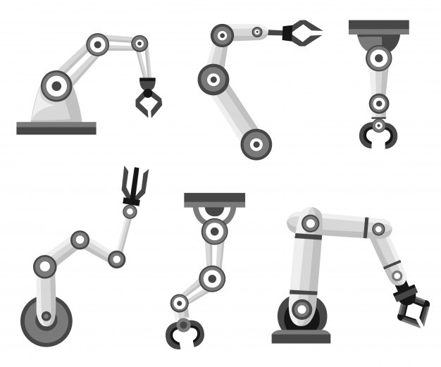
WORKING PARTS
On the basis of work it has been divided in to following three parts:
KEYPAD INTERFACE
LCD DISPLAY
STEPPER MOTORS/ROBOTIC ARM

Slide 9
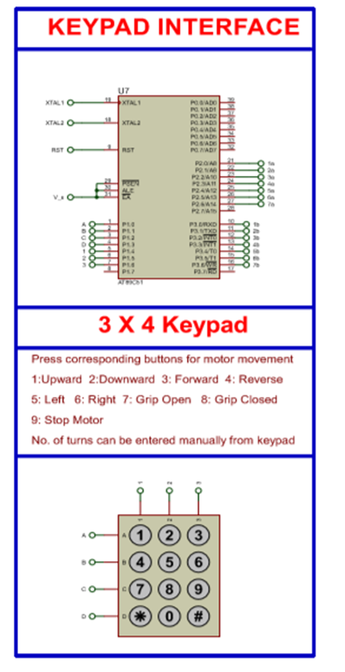
KEYPAD INTERFACE
This keypad based on AT89C51 will give manual instruction for movement of motors.
These 9 sets of have their function displayed on the keypad .
User can also controls motor no. of turns.

Slide 10
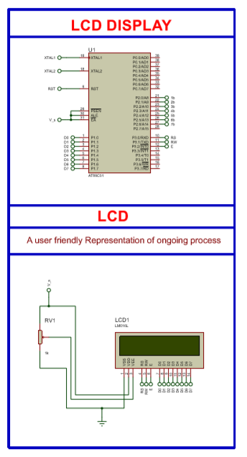
LCD DISPLAY
An user friendly LCD representation based on AT89C51 microcontroller is used.
It will give information about the function which is being currently carried out by motors.
Inputs given by user from keypad are also visible on LCD.

Slide 11
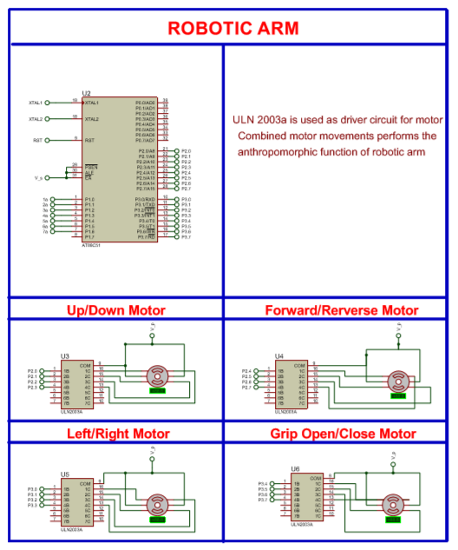
ROBOTIC ARM
Working of robotic arm is controlled by stepper motors
Combined clockwise and anticlockwise movement of motors will form the basic movement of robotic arm.
To drive stepper motors ULN2003a is used as driver circuit.

Slide 12
RESULTS/ SCOPE
If more time and more efforts would have been put into the model the definitely more complexity could have been brought out of it .
Moreover instead of manual operation of functions and controller could have been replaced by pre-defined computer program or merely by pressing switch operated.
These keys once pressed will remain save indefinitely to perform the specific function unless stopped to do so.
Further more varieties and more flexibility to add or replace any part according to the requirements can be done to improve its use and increase field of usage and to make it more universal or flexible.

Slide 13
CONCLUSION:
We deduced that in comparison to humans, robots can be much stronger and are therefore able to lift heavier weights and exert larger forces.
They can be very precise in their movements, reduce labor costs, improve working conditions, reduce material wastage and improve product quality.
It implements Intelligent Machines (IMs) to perform anthropomorphic tasks with minimum supervision and interaction with a human operator.
This project can be further enhanced to as a multi-disciplinary project involving electrical and mechanical engineers to work together to create more complex, intelligent robots controlled by the AT89C51 micro-controller.

Slide 14
